Slide 1

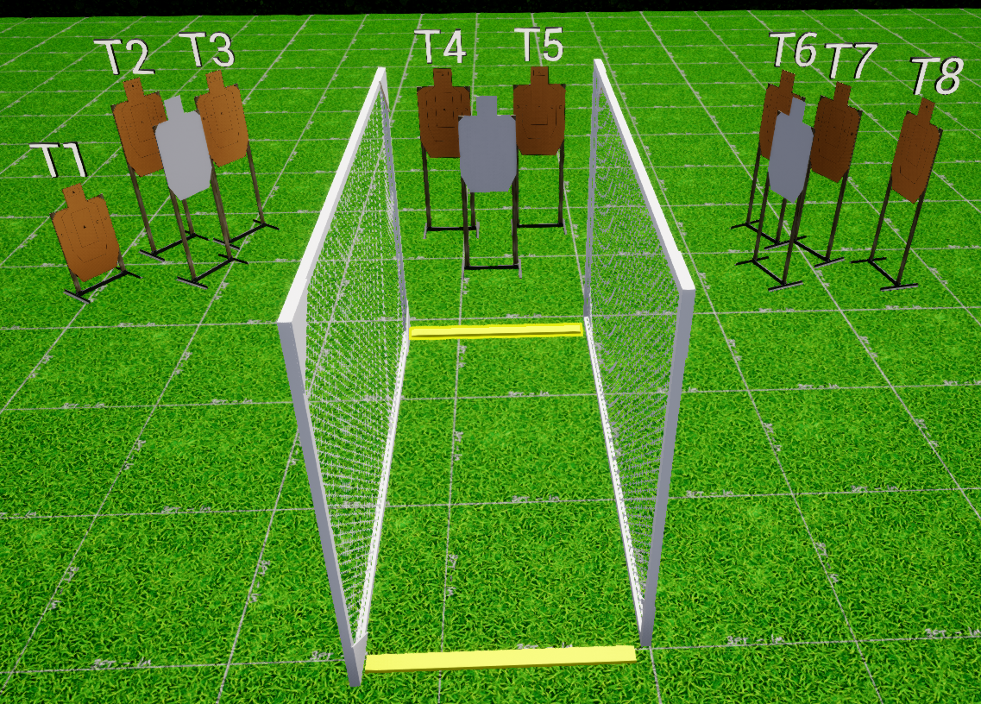
 | Interlake Sporting Association Action Bay, A Stage: Course Designer: Nathan Jarvis
START POSITION: Heels touching starting fault line. Handgun: Loaded and holstered, wrists below belt. PCC: Stock on belt, muzzle pointed downrange. |  | STRINGS: 1 SCORING: Unlimited ROUND COUNT: 8 START-STOP: Audible - Last shot
STAGE PROCEDURE: At the start signal, engage T4&T5 in the open, then engage all remaining targets from P1. Reload required between first and last shot
P1
Start

